Slide 1
Regression for Predictive Modeling

Slide 2
Regression for Predictive Modeling vs Hypothesis Testing
Hypothesis Testing
Predictive Modeling
Data should be from a designed experiment
All data are used
The purpose of the analysis is hypothesis testing, the analysis ends after a conclusion in regards to the null hypothesis (using the p-value) is made and summarized
Data are often from an existing database (data driven analysis)
Data are divided into training and testing sets
We want to see significant hypothesis tests, but more importantly we want to quantify prediction error and uncertainty through test/validation data

Slide 3
Keys Points in Professional Predictive Models
Before a business uses a model, it should ALWAYS be evaluated on a set of data NOT use to build the model (this can be done with a simple split of available data into training and testing data sets, or through cross validation with folding)
The uncertainty in a prediction should ALWAYS be quantified, multiple methods can be used: RMSE, MAE, prediction intervals—the test data (data withheld) should be used for quantifying uncertainty
A significant hypothesis test is a starting point for a predictive model, not evidence of its effectiveness
Notes:
Always quantify your error.

Slide 4
Training and Test Data Sets
Dividing your data into a training and test data set and trying out your model on the test data is a minimum expectation for all predictive modeling problems (regression, random forests, artificial neural networks, etc.)
The idea is you only use a portion of the available data to build or “train” your model (or other data mining technique)
The other portion of the data is withheld and then used to test the model to provide a non-biased view of how the model performs
The test data set is also sometimes called a “validation” data set

Slide 5
Splitting the data into training and test data sets
Generally, we want to divide the data randomly (this can be done by using pseudo-random number generation and then sorting the data based on the random numbers)
How we divide the data into test and training sets can vary, typically you want more data in the training data set than the test data set
A common practice is to use 50 to 80% of the data for building the model and the other 20 to 50% of the data for testing the model

Slide 6
Cross validation with folding
An innovating way of dividing data into training and test data that is commonly used for model building is “cross validation with folding”
The idea is to create multiple training data and test data sets from the data available to build a model (with clever replacement to get the most out of our data)
The training data are still used to build the model and the test data are still used to evaluate the model’s performance
In cross validation, the test data are called “out of sample” data, and the error calculated on the test data will be called “out of sample error” or “OOS error”

Slide 7
Cross validation with folding (continued)
The number of “folds” must be selected (a good number of folds from literature is 5 to 10; we will use 5)
On the following slide is an example of how cross validation with folds works on an unrealistically small data set (so that we can see what is happening)

Slide 8
Cross-validation with 5 folds example:
Data available for regression:
sqft | saleprice
1326 | 66960
1391 | 80400
1000 | 45600
1542 | 74400
735 | 45360
1444 | 91920
1796 | 108000
1770 | 104400
1708 | 99600
1529 | 85200
sqft | saleprice
1326 | 66960
1391 | 80400
1000 | 45600
1542 | 74400
735 | 45360
1444 | 91920
1796 | 108000
1770 | 104400
1708 | 99600
1529 | 85200
Start by dividing the data into 5 folds (this should be done randomly, so in our example we will assume the 10 rows of data have been randomly sorted)
1.
2.
3.
4.
5.

Slide 9
Cross-validation with 5 folds example: (continued)
sqft | saleprice
1326 | 66960
1391 | 80400
1000 | 45600
1542 | 74400
735 | 45360
1444 | 91920
1796 | 108000
1770 | 104400
1708 | 99600
1529 | 85200
The regression model will be fit 5 times, the first time, folds 1-4 will be used to build the regression model to predict saleprice from sqft and fold 5 will be used as the test data (OOS error will be calculated for the test data)
1.
2.
3.
4.
5.
Use as training data
Use as test data

Slide 10
Cross-validation with 5 folds example: (continued)
sqft | saleprice
1326 | 66960
1391 | 80400
1000 | 45600
1542 | 74400
735 | 45360
1444 | 91920
1796 | 108000
1770 | 104400
1708 | 99600
1529 | 85200
1.
2.
3.
4.
5.
The second time, folds 1,2,3, and 5 will be used to build the regression model and fold 4 will be used as the test data (OOS error again only calculated from fold 4).
Use as training data
Use as test data

Slide 11
Cross-validation with 5 folds example: (continued)
sqft | saleprice
1326 | 66960
1391 | 80400
1000 | 45600
1542 | 74400
735 | 45360
1444 | 91920
1796 | 108000
1770 | 104400
1708 | 99600
1529 | 85200
This process is repeated until each fold has been used as the test data once. The OOS error is then averaged to provide an accurate estiate of how the model will make predictions.
1.
2.
3.
4.
5.
Use as test data
Use as training data

Slide 12
Using R to build our regression model

Slide 13
Housing Data
housing.csv

Slide 14
R Code to set up the cross-validation
#house <-read.csv("C:/Users/hbrown11/Desktop/housing.csv", header=TRUE)
head(house)
install.packages("caret") #only needs to be installed once
library(caret)
#we set a seed so that the random sampling will be repeatable
set.seed(42)
# Set up 5-fold cross-validation
train_control <- trainControl(method = "cv",number = 5)
# fit the model
model <- train(saleprice ~sqft, data = house,
method = "lm",
trControl = train_control)

Slide 15
Evaluating the model
> print(model)
Linear Regression
60 samples
1 predictor
No pre-processing
Resampling: Cross-Validated (5 fold)
Summary of sample sizes: 48, 48, 48, 48, 48
Resampling results:
RMSE Rsquared MAE
8081.006 0.9614087 6023.899
Notes:
Mult RMSE x2 to get +- how off it is.
Better Rsquared
MAE how on average you are wrong.

Slide 16
Evaluating the model
All three are calculated for you in R using the out of sample data (test data):
Root mean square error
R²
Mean absolute error
Without cross-validation (using only the data used to build the model), these three values will inaccurately represent the predictive ability of the model

Slide 17
Root Mean Square Error (RMSE) for Test Data
RMSE = square root of Σ((observed –predicted)²/n)
Subtract each predicted value from the test data from the observed (true) value, square it, take the average and then the square root.
It is analogous to the “standard deviation” of prediction errors

Slide 18
R²
It is the correlation coefficient squared.
It is calculated by dividing the sum of the squares of the residuals by the sum of the squares of the observations:
1 - Σ((observed –predicted)²/ Σ(observed –mean of observed))²
The closer to 1 the higher proportion of the variation in the data is explained by the model (a value of 1 means 100% of variation is explained by the model; a value of 0 means 0% of variation is explained by the model

Slide 19
Mean Absolute Error (MAE)
MAE = Σ(|observed –predicted|/n
Subtract each predicted value from the test data from the observed (true) value, take the absolute value. Take the average.
Can be interpreted as on average how wrong a single prediction will be
(MAPE is similar, but converts MAE to a percentage)

Slide 20
Evaluating our real estate model
For our, out of sample results:
Root mean square error = 8081
R² = 0.961
Mean absolute error = 6024
The mean absolute error means that, on average, we would expect a house sale price prediction made by our model to be wrong by $6,024.
The r-square indicates our model explains about 96% of the variation in the data.
The root mean square error can be used to provide rough confidence bounds for the prediction; multiple the RMSE by 2 and add and subtract it from a prediction to get a rough 95% prediction bound $8,081*2 = $16,162; a prediction we make using this model for a home sale price we would expect to be within +/- $16,162 of the true selling price 95% of the time

Slide 21
Evaluating our real estate model…based on the OOS Error Metrics is this a good model?
What is considered a “good” model is completely relative—it depends on the business context.
There is nothing in our hypothesis tests or OOS error to indicate this model should not be used, but if it is a good model depends on questions such as:
What is the business currently using to make predictions of home sale prices? Is this better? How good are our competitors’ models? What kind of error rates can our decision makers live with?
Said another way, your model should be better than a random guess, but other than that, there are no “absolutes” when it comes using MSE, R-square, and MAE to evaluate a model. (For one situation a OOS R-square of 0.96 may be too inaccurate to be a useful model; in another completely different situation, using a model with an OOS R-square of 0.39 might significant improve profits for a company.)

Slide 22
Viewing the model (and hypothesis tests)
summary(model)
The output from this code should look like:
Residual information that we will ignore because we will look at a plot that will tell us more than this
Residuals:
Min 1Q Median 3Q Max
-20448 -3536 -2110 2285 21115
Coefficients:
Estimate Std. Error t value Pr(>|t|)
(Intercept) -31246.873 3485.634 -8.964 1.52e-12 ***
sqft 78.812 2.221 35.483 < 2e-16 ***
---
Signif. codes: 0 ‘***’ 0.001 ‘**’ 0.01 ‘*’ 0.05 ‘.’ 0.1 ‘ ’ 1
Residual standard error: 8030 on 58 degrees of freedom
Multiple R-squared: 0.956, Adjusted R-squared: 0.9552
F-statistic: 1259 on 1 and 58 DF, p-value: < 2.2e-16
These are the coefficients (or slope and intercept) of our regression model
The values to the right with *** next to it, signify that the slope and intercept are significant
The p-value of the F-statistics also tells us the regression model is significant

Slide 23
A note on hypothesis tests
In a traditional statistical experiment where regression is used to test a hypothesis, the t-tests and F-test play the key role.
In predictive modeling, while we generally want to see a significant F-test and significant slope, we place more emphasis on evaluating the model with the test data set

Slide 24
Interpreting the results and using the model
house price estimate = -31246.873 + 78.812 *(square footage)
For a 1200 sqft house, we could estimate a sale price of:
House price estimate = -31246.873 + 78.812 *(1200)
House price estimate = $63,327.53
Note: we should only make predictions for values of square-footage that were within the range of square-footages that were used to build the model (use summary(house) to find the max and min). Making a prediction for a value out side the range used to build the model is extrapolation and will give untested and unreliable results (for example, plugging 300 in for sqft in our model gives a negative selling price)

Slide 25
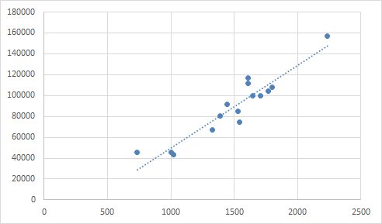
Visualizing how regression works
The regression line is calculated so that the distance from each point to the line is minimized

Slide 26
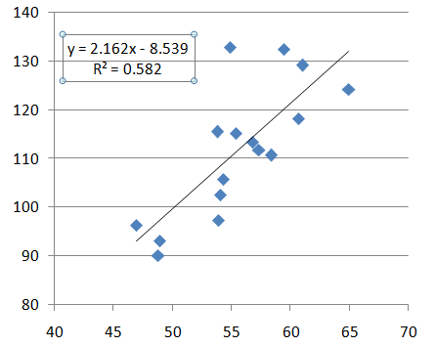
Prediction Intervals for Regression Algorithms
Ordinary least squares linear regression lines seek to fit a regression line (curve, plane, surface, hyper-plane, etc. when more than one input is involved) in a way that minimize the distance from the input points to the regression model. Prediction intervals for an individual prediction can be calculated (some times call confidence intervals)
Confidence limits are
calculated assuming normally
distributed error

Slide 27
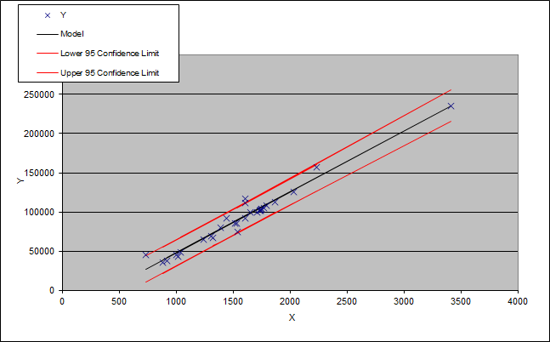
Prediction Intervals for Regression Algorithms
So for our house sale price/square footage example, the red lines in the graph below would be the 95% prediction limits. Quantifying uncertainty in this way is always better for supporting decisions. So instead of just saying something like a 3000 square foot house will sale for $204,000, we can say we expect 95% of 3000 square foot houses to sell between $185,000 and $222,000
In predictive modeling confidence limits on individual values is more meaningful than confidence limits on model parameters!

Slide 28
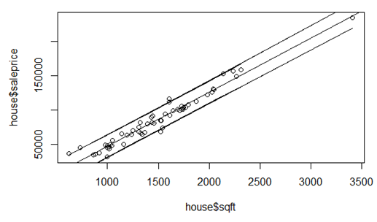
R code for prediction limits and to plot the results
regmodel<-lm(saleprice~sqft,data=house)
plot(house$sqft,house$saleprice)
abline(regmodel)
pred_interval <- predict(regmodel, newdata=house, interval="prediction",level = 0.95)
lines(house$sqft, pred_interval[,2])
lines(house$sqft, pred_interval[,3])
Level=0.95 asks for 95% intervals, if you want 99% intervals (wider limits to account for more data), it can be changed to 0.99

Slide 29
Using the model

Slide 30
R Code to use if we want to make a prediction (and include confidence intervals)
newdata=data.frame(sqft=1400)
predict(regmodel,newdata=newdata,interval="prediction",level=0.95)
fit lwr upr
79090.41 62876.44 95304.38
This code gives the predicted sale price for a square footage of 1400
It gives our best estimate for the sale price and then a lower and upper bound for two sale prices we are 95% sure the true sale price will be between.
What sqft values is the model valid for?
Use the following to see the min and max values of sqft:
summary(house)
The model can be used for values between 620 and 3410 square feet.

Slide 31
When to Use Regression:
If you are trying to predict numeric data (the column contains continuous data). Examples: to predict the amount of sales, to predict the amount of bacteria, to predict ACT scores, to predict the point spread in a game, etc.
If you need to predict a discrete variable (character or text data in a column) you have a classification problem, which we will cover later in this course
You may have one or more input columns (i.e. independent variables) and these columns can be either discrete (text) or continuous (numeric)
There must be a relationship between the column you are trying to predict and the input columns for your regression to be useful (for example, regression can’t be used to predict the winning lottery numbers, because the lottery is random and therefore has no relationships to other data)

Slide 32
Full code for example 1
#house <-read.csv("C:/Users/hbrown11/Desktop/housing.csv", header=TRUE)
head(house)
#install.packages("caret") #only needs to be ran once
library(caret)
set.seed(42)
train_control <- trainControl(method = "cv",number = 5)
model <- train(saleprice ~sqft, data = house, method = "lm", trControl = train_control)
print(model)
summary(model)
regmodel<-lm(saleprice~sqft,data=house)
plot(house$sqft,house$saleprice)
abline(regmodel)
pred_interval <- predict(regmodel, newdata=house, interval="prediction",level = 0.95)
lines(house$sqft, pred_interval[,2])
lines(house$sqft, pred_interval[,3])
summary(house)
newdata=data.frame(sqft=1400)
predict(regmodel,newdata=newdata,interval="prediction",level=0.95)

Slide 33

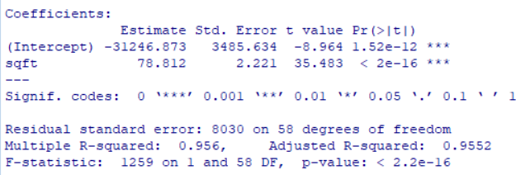
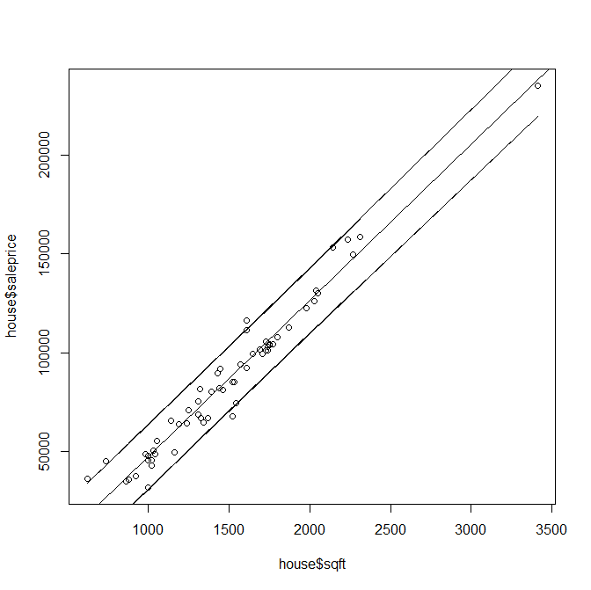
Relevant Output

Slide 34
Discussion of Results
A predictive model using ordinary least squares linear regression was built to predict house sale price using square footage
The model may be written as
house price estimate = -31246.873 + 78.812 *(square footage)
It is valid for square footages from 620 to 3410
The model was highly significant (p-value <0.0001)
For out of sample predictions, the RMSE is 8081, the R-Square is 0.96, and the MAE is 6204. On average, we can expect a prediction made by this model to be wrong by $6024

Slide 35
Example 2
Download the file tenders.txt
These data are real data from the food industry
The poultry company wants to be able to predict tender weight (an expensive piece of chicken breast meat) by measuring live weights (which can be done in advance on a farm)
This will give the company advance knowledge on how much product they will have between certain weight ranges
The tenders file has a column “tenders” and a column “live”, we want to predict the tenders weight from the live weight column
Use the example program for retail to try and complete this example

Slide 36
Do the following:
Set-up 5-fold cross validation
Check statistical hypothesis tests
Create 95% prediction intervals for individual predictions (and plot these)
Calculate MSE, R-square, and MAE for the out of sample data
Use the model to make a prediction
Briefly discuss the results
Try to do this on your own (solution on the next page)

Slide 37
R program for tender problem
#tenders <-read.csv("C:/Users/hbrown11/Desktop/tenders.csv", header=TRUE)
head(tenders)
#install.packages("caret") #only needs to be ran once
#library(caret) #still loaded if you did the house ex in the same session
set.seed(42)
train_control <- trainControl(method = "cv",number = 5)
model <- train(tenders ~live, data = tenders, method = "lm", trControl = train_control)
print(model)
summary(model)
regmodel<-lm(tenders~live,data=tenders)
plot(tenders$live,tenders$tenders)
abline(regmodel)
pred_interval <- predict(regmodel, newdata=tenders, interval="prediction",level = 0.95)
lines(tenders$live, pred_interval[,2])
lines(tenders$live, pred_interval[,3])
newdata=data.frame(live=3500) #don't make predictions for x outside the range used to build the model
predict(regmodel,newdata=newdata,interval="prediction",level=0.95)

Slide 38
What was changed in our program for a new data set?
#tenders <-read.csv("C:/Users/hbrown11/Desktop/tenders.csv", header=TRUE)
head(tenders)
#install.packages("caret") #only needs to be ran once
#library(caret) #still loaded if you did the house ex in the same session
set.seed(42)
train_control <- trainControl(method = "cv",number = 5)
model <- train(tenders ~live, data = tenders, method = "lm", trControl = train_control)
print(model)
summary(model)
regmodel<-lm(tenders~live,data=tenders)
plot(tenders$live,tenders$tenders)
abline(regmodel)
pred_interval <- predict(regmodel, newdata=tenders, interval="prediction",level = 0.95)
lines(tenders$live, pred_interval[,2])
lines(tenders$live, pred_interval[,3])
newdata=data.frame(live=3500) #don't make predictions for x outside of y range
#summary(tenders) #this will show the live max and min
predict(regmodel,newdata=newdata,interval="prediction",level=0.95)

Slide 39

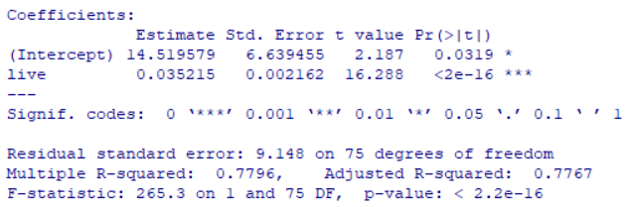
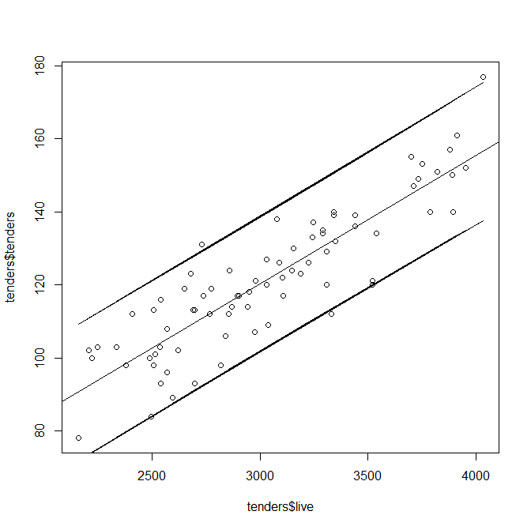
Relevant Output

Slide 40
Discussion of Results
A predictive model using ordinary least squares linear regression was built to predict tender weight using live weight
The model may be written as
tender = 14.519579+ 0.035215 *(live)
It is valid for live weights from 2160 to 4031 (grams)
The model was highly significant (p-value <0.0001)
For a live weight of 3500g, the model predict a tender weight of 138g (with 95% prediction intervals of 119 and 156, i.e. our best guess of a tender weight for a 3500g live weight is 138g, but we are approximately 95% certain it will be between 119g and 156g)
For out of sample predictions, the RMSE is 9.2, the R-Square is 0.80, and the MAE is 7.4. On average, we can expect a prediction made by this model to be wrong by 7.4g.

